Slide 1


ORDERS & CUSTOMERS
ANALYSIS
INSIGHTS FROM BRAZILLIAN E-CCOMMERCE
MERCADO LIVRE
BY MANAN SHAH
DATE: 2 JUNE, 2025
01

Slide 2


PROBLEM
STATEMENT
E-commerce platform Mercado Livre generate massive datasets involving orders, customers, products, and sellers. Making sense of this data is crucial to understand sales trends, product performance, customer behavior, and seller contributions. The goal of this analysis is to uncover actionable insights such as top product categories, repeat customer behavior, and yearly growth trends to help drive better decision-making.
02

Slide 3
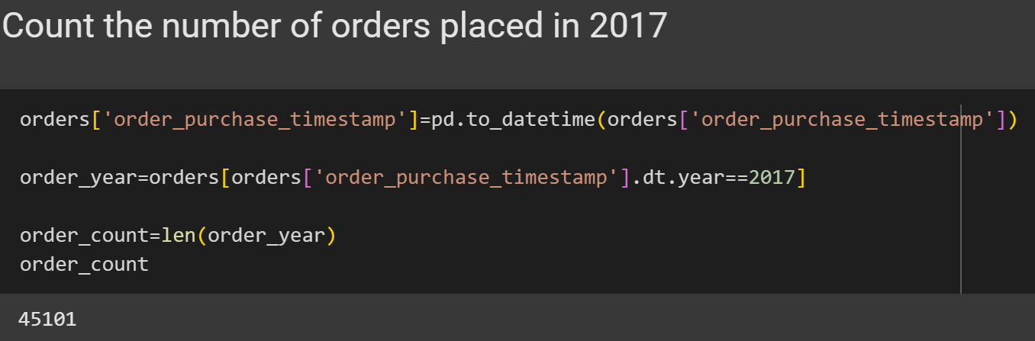
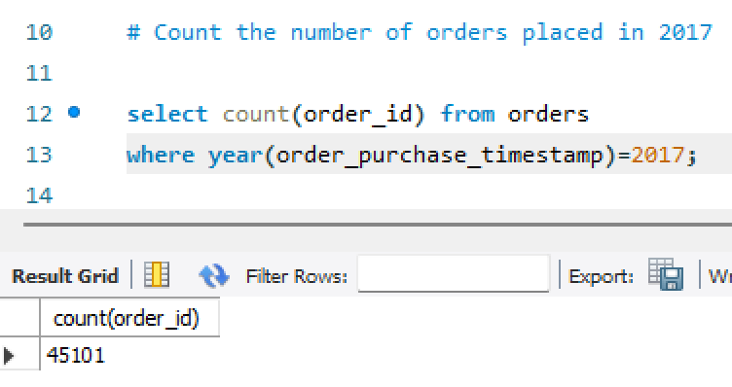
KEY INSIGHTS
TOTAL ORDERS IN 2017
This is used to find out how many total orders were placed by customers during the year 2017.
It selects and counts all the order IDs from the orders table where the year part of the order date is 2017.
It shows the total number of orders made in 2017, which helps us understand how many purchases happened that year.
03

Slide 4
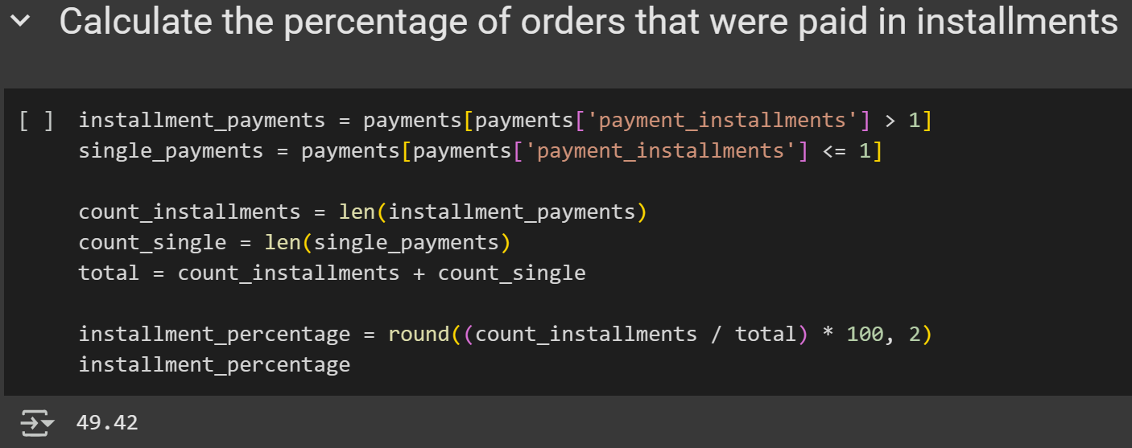
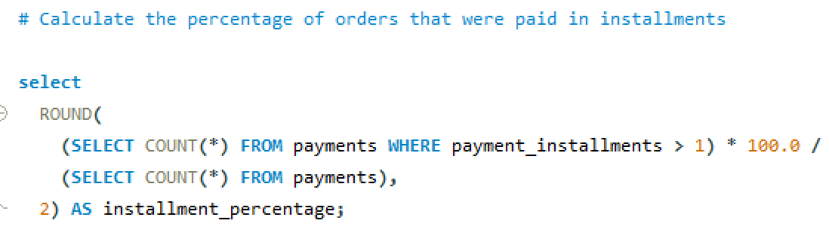
ORDER% PAID IN INSTALLMENTS
This calculates the percentage of total orders that were paid using installments rather than in full.
It divides the number of payments where installments were more than 1 by the total number of payments, multiplies by 100 to get a percentage, and rounds it to two decimal places.
It tells us how common installment payments are among customers, giving insight into customer payment behavior and preferences.
04

Slide 5
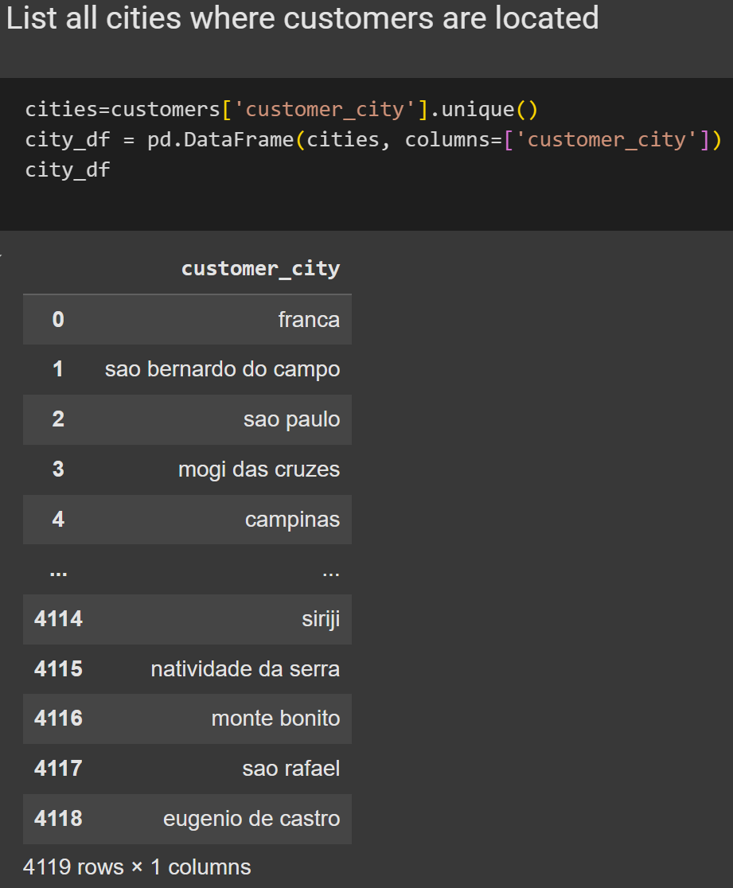
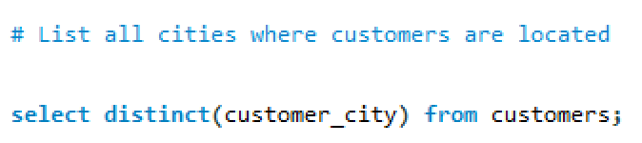
CUSTOMER BY
CITIES
This query lists all the unique cities where customers are located.
The query works by selecting only unique city names so that each city appears only once in the result.
As a result, we get a list of cities without any repetitions, showing where our customers are located.
The output will be a single-column list of city names like "sao paulo", "curitiba", "rio de janeiro", etc. — giving us insights into the geographic spread of customers.
04

Slide 6
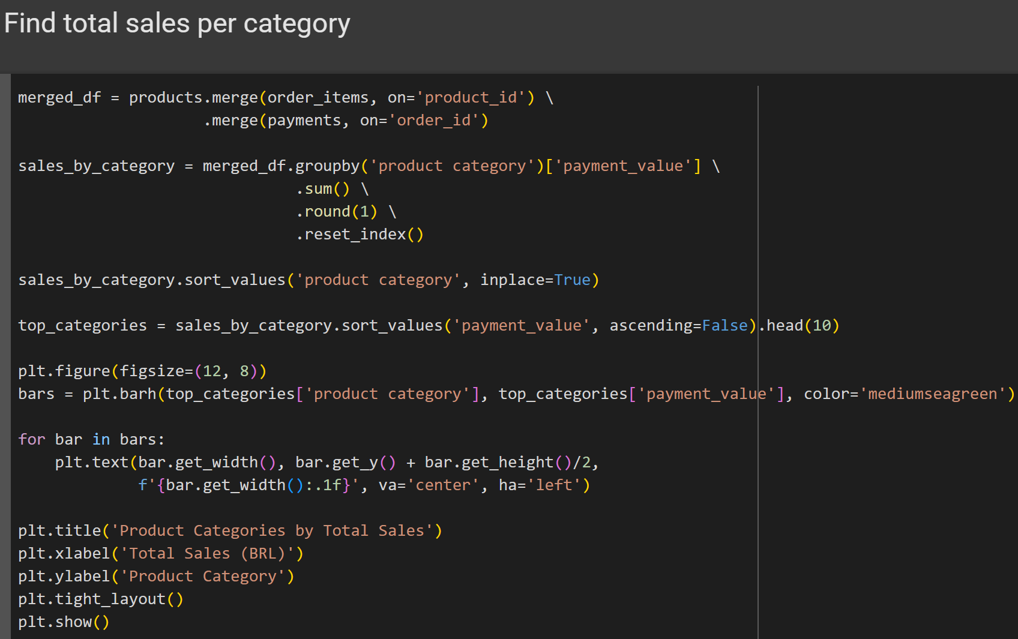
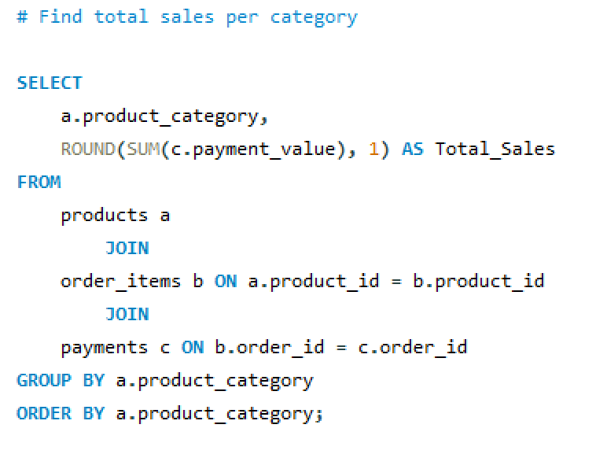
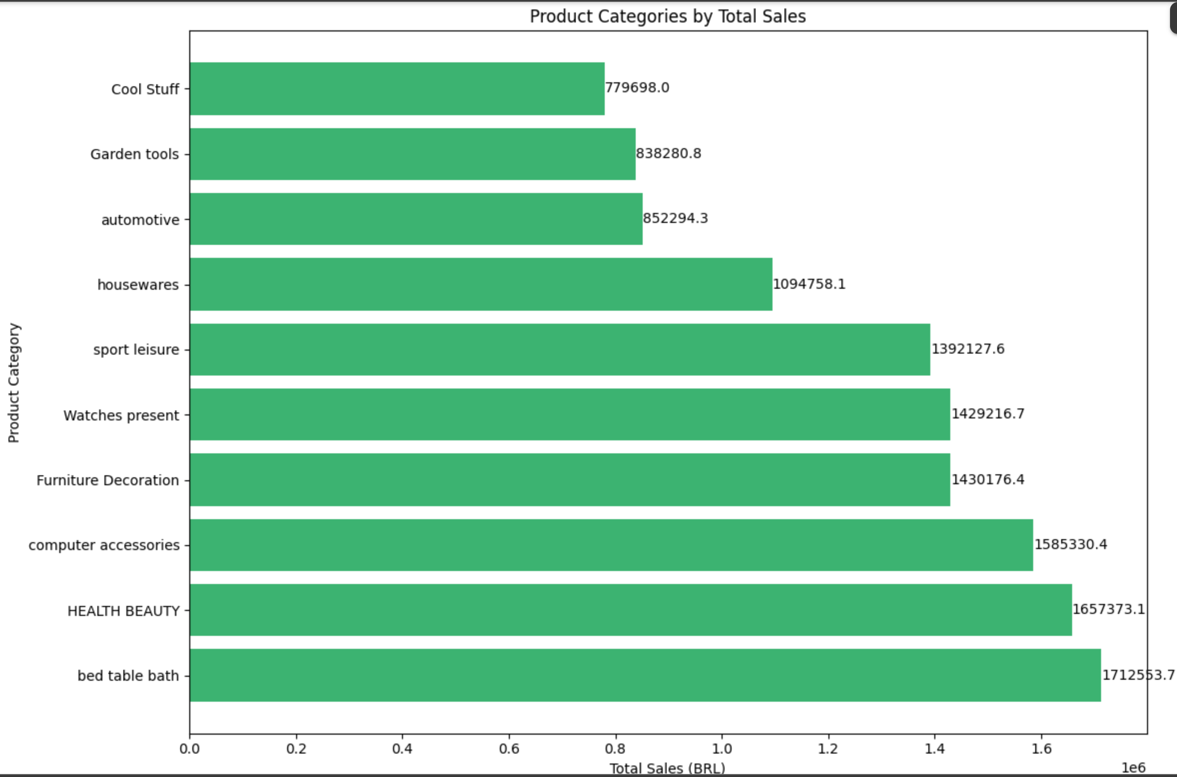
PRODUCT CATEGORY
SALES
This calculates the total sales amount (payment value) for each product category.
It joins the products, order_items, and payments tables using product and order IDs, then groups the results by product category and sums the payment values.
It shows how much revenue each product category has generated, helping us understand which categories contribute more or less to the total sales.
Categories like bed_table bath perform well with high sales of around 12,992 BRL, while categories like la_cuisine perform poorly with sales of just 12 BRL, indicating uneven performance across product categories.
05

Slide 7
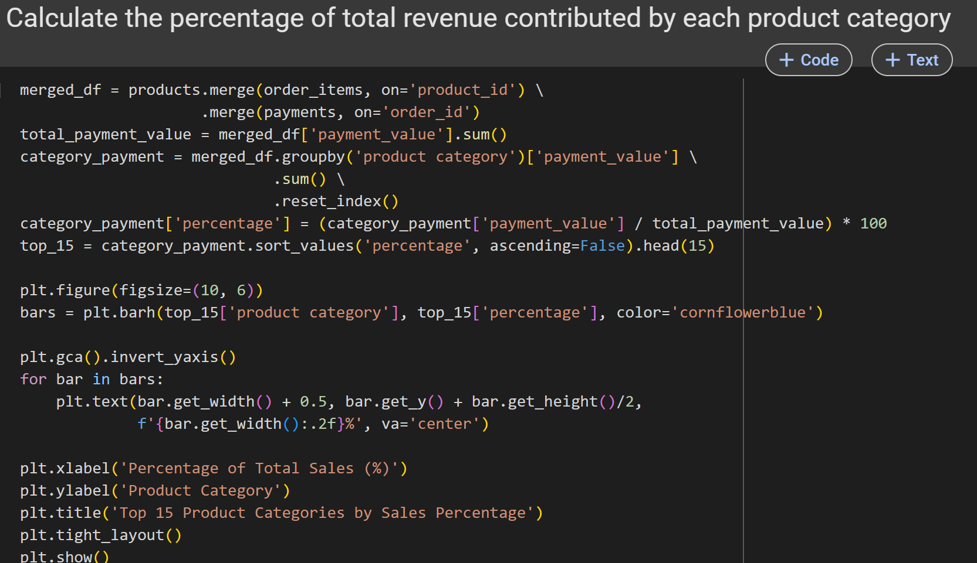
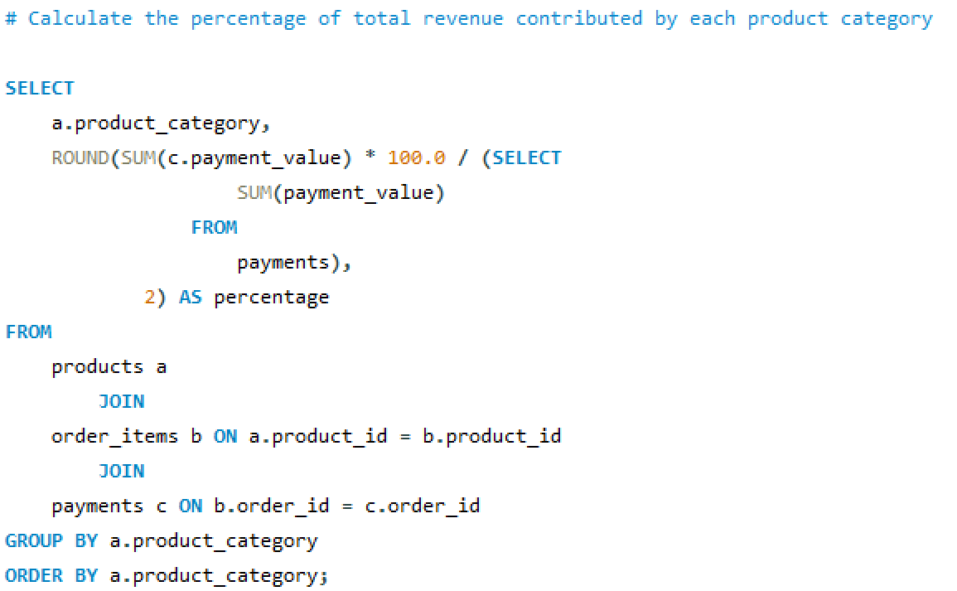
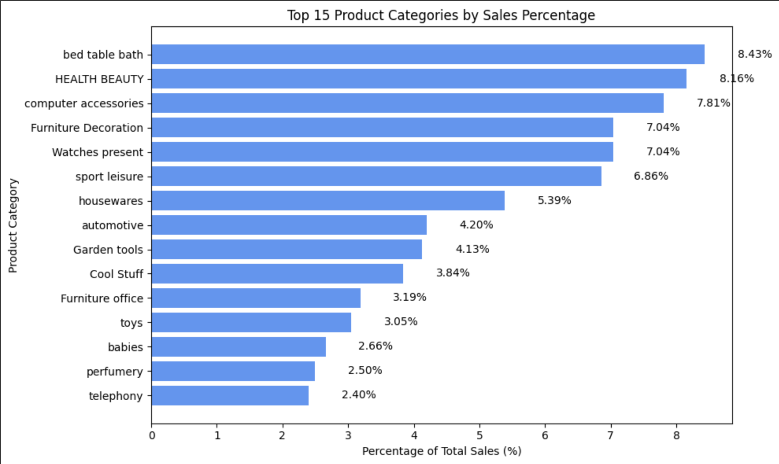
PRODUCT CATEGORY
SHARE OF TOTAL SALES
This finds out what percentage of total revenue each product category contributes to the overall sales.
It joins the products, order_items, and payments tables, sums the payment values per product category, then divides each category’s total by the overall payment value sum and multiplies by 100 to get the percentage.
It shows the relative contribution of each category to the company’s entire revenue, not just the raw sales amount.
The bed_bath_table category contributes the most with 8.93% of the total revenue, while security_and_services contributes the least with just 0.02%, highlighting which categories are driving business and which may need re-evaluation or promotion.
06

Slide 8
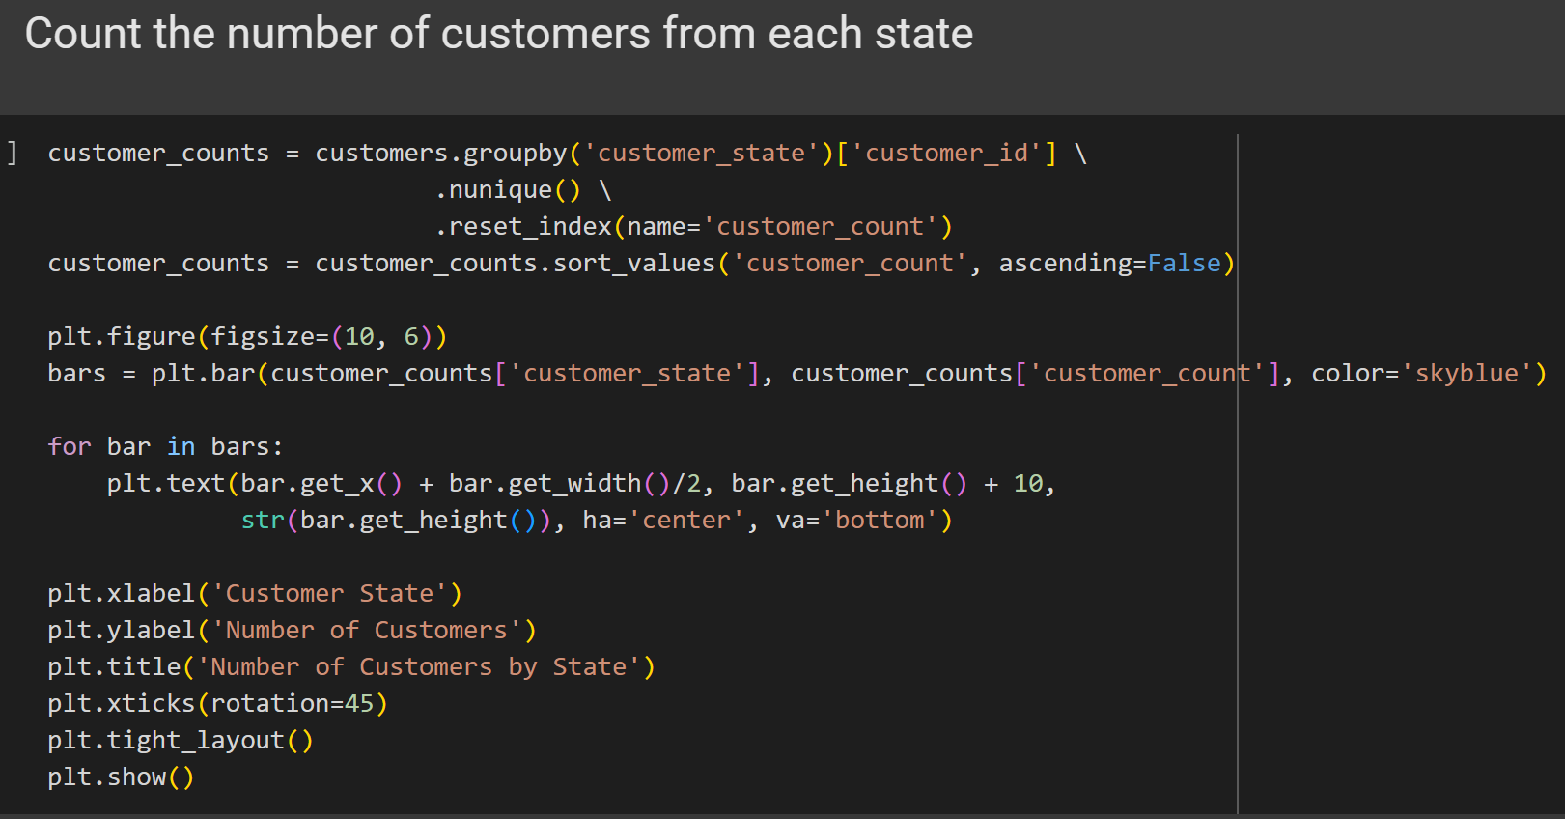
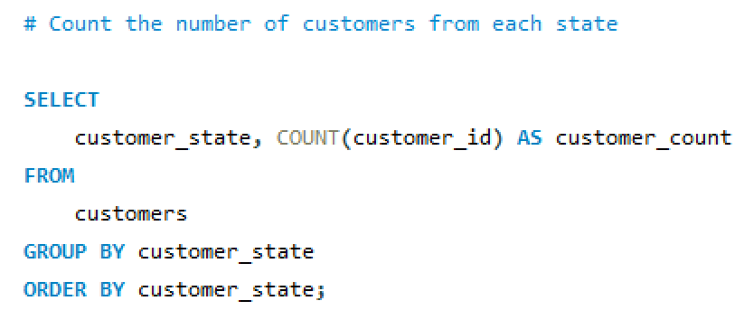
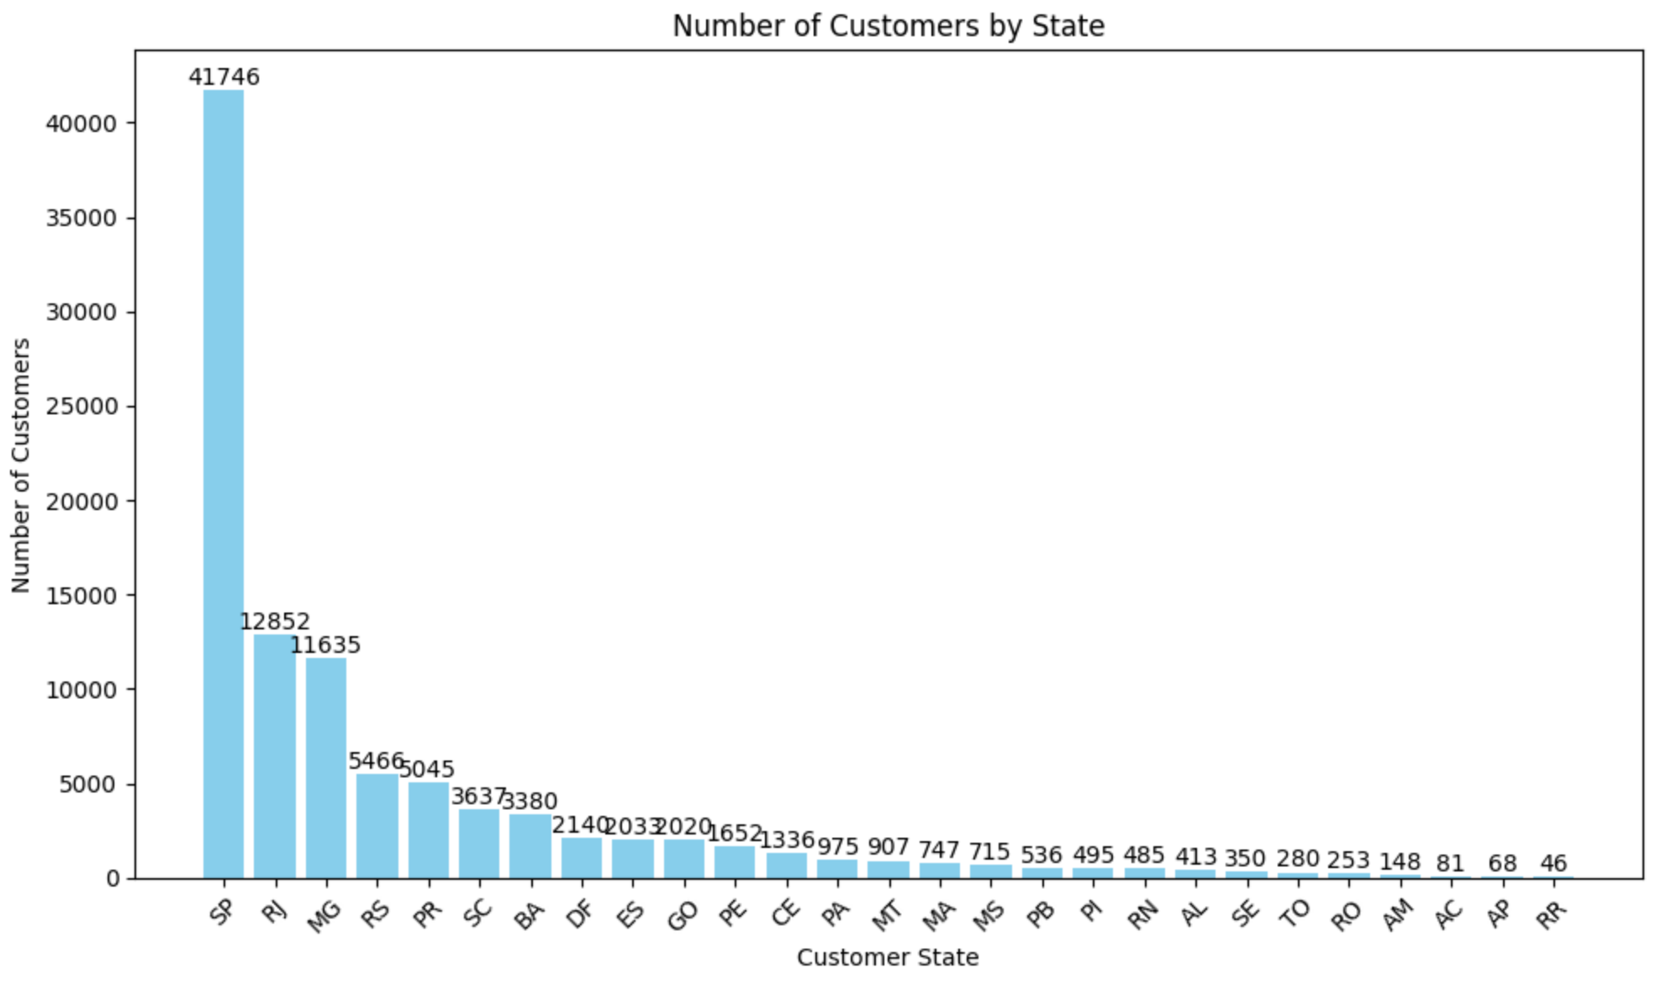
CUSTOMER DISTRIBUTION
BY STATE
This counts how many customers are from each state.
It groups the customers table by the customer_state column and counts the number of customers in each group.
It shows the number of customers living in each state, helping identify where most customers are located geographically.
States like SP (São Paulo) have the highest number of customers, indicating a strong market presence, while states like RR with fewer customers may offer opportunities for expansion or targeted marketing.
07

Slide 9
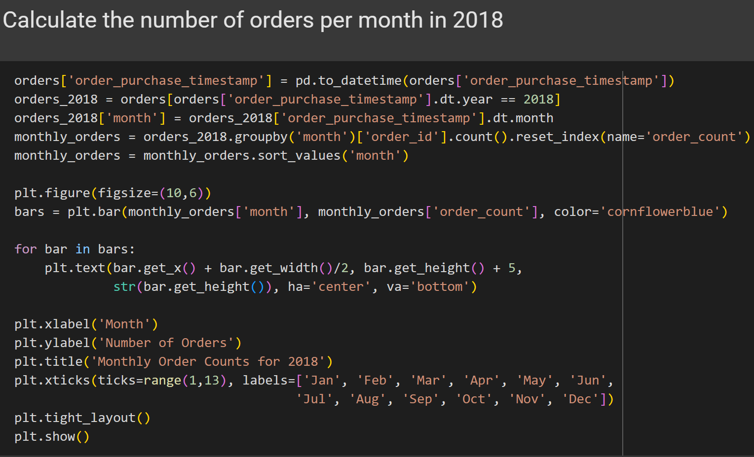
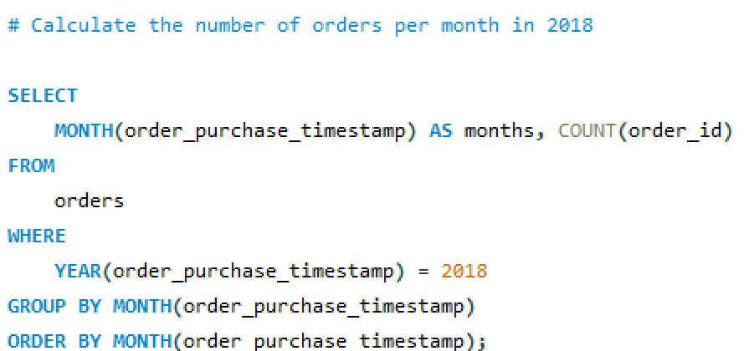
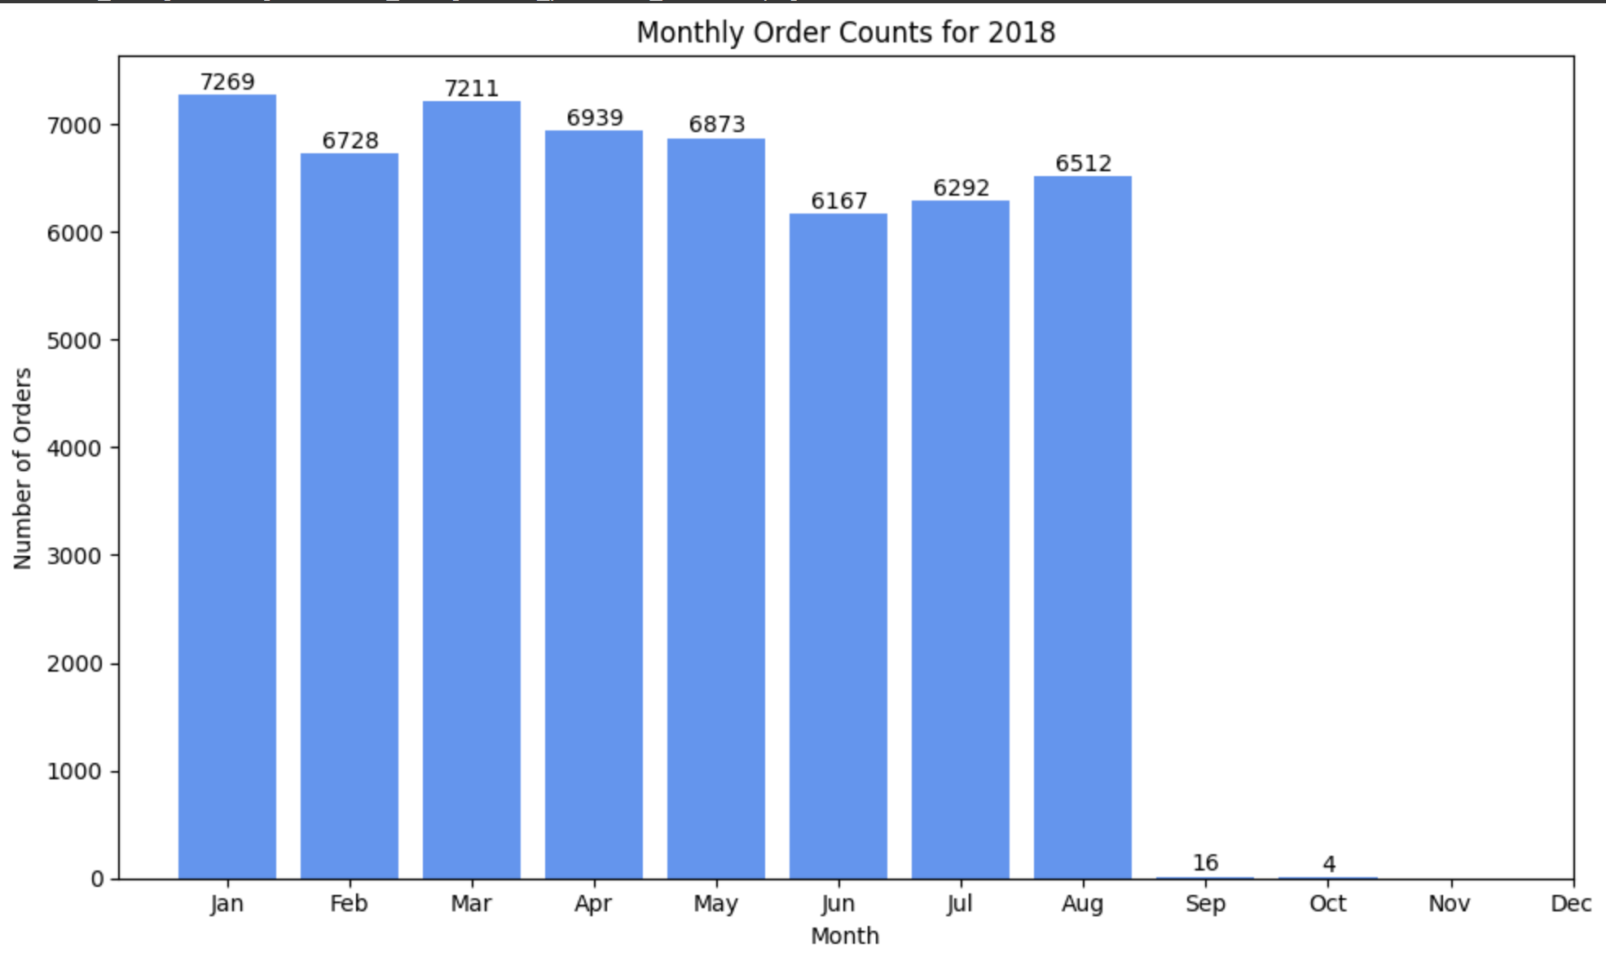
ORDERS PER MONTH
IN 2018
This calculates how many orders were made in each month of the year 2018. It helps you understand the monthly trend in customer orders during that year.
To do this, we use the order date column from the orders table or dataset. We focus only on the year 2018 and then group the data by month.
It helps us understand the monthly distribution of orders, showing which months had higher or lower order volumes.
The output shows that January had the highest number of orders, while December had the lowest.
07

Slide 10
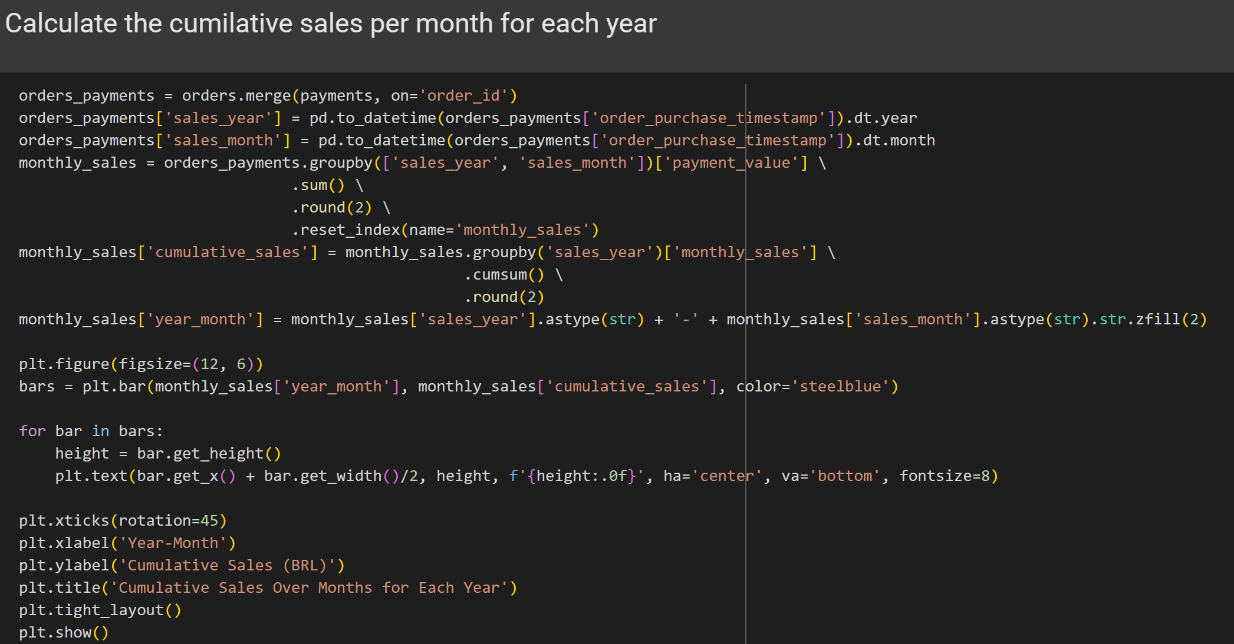
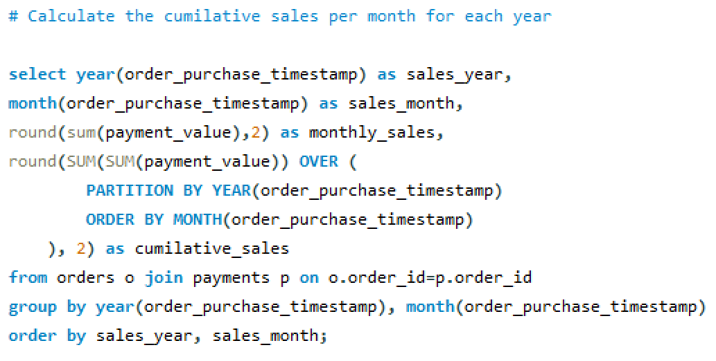
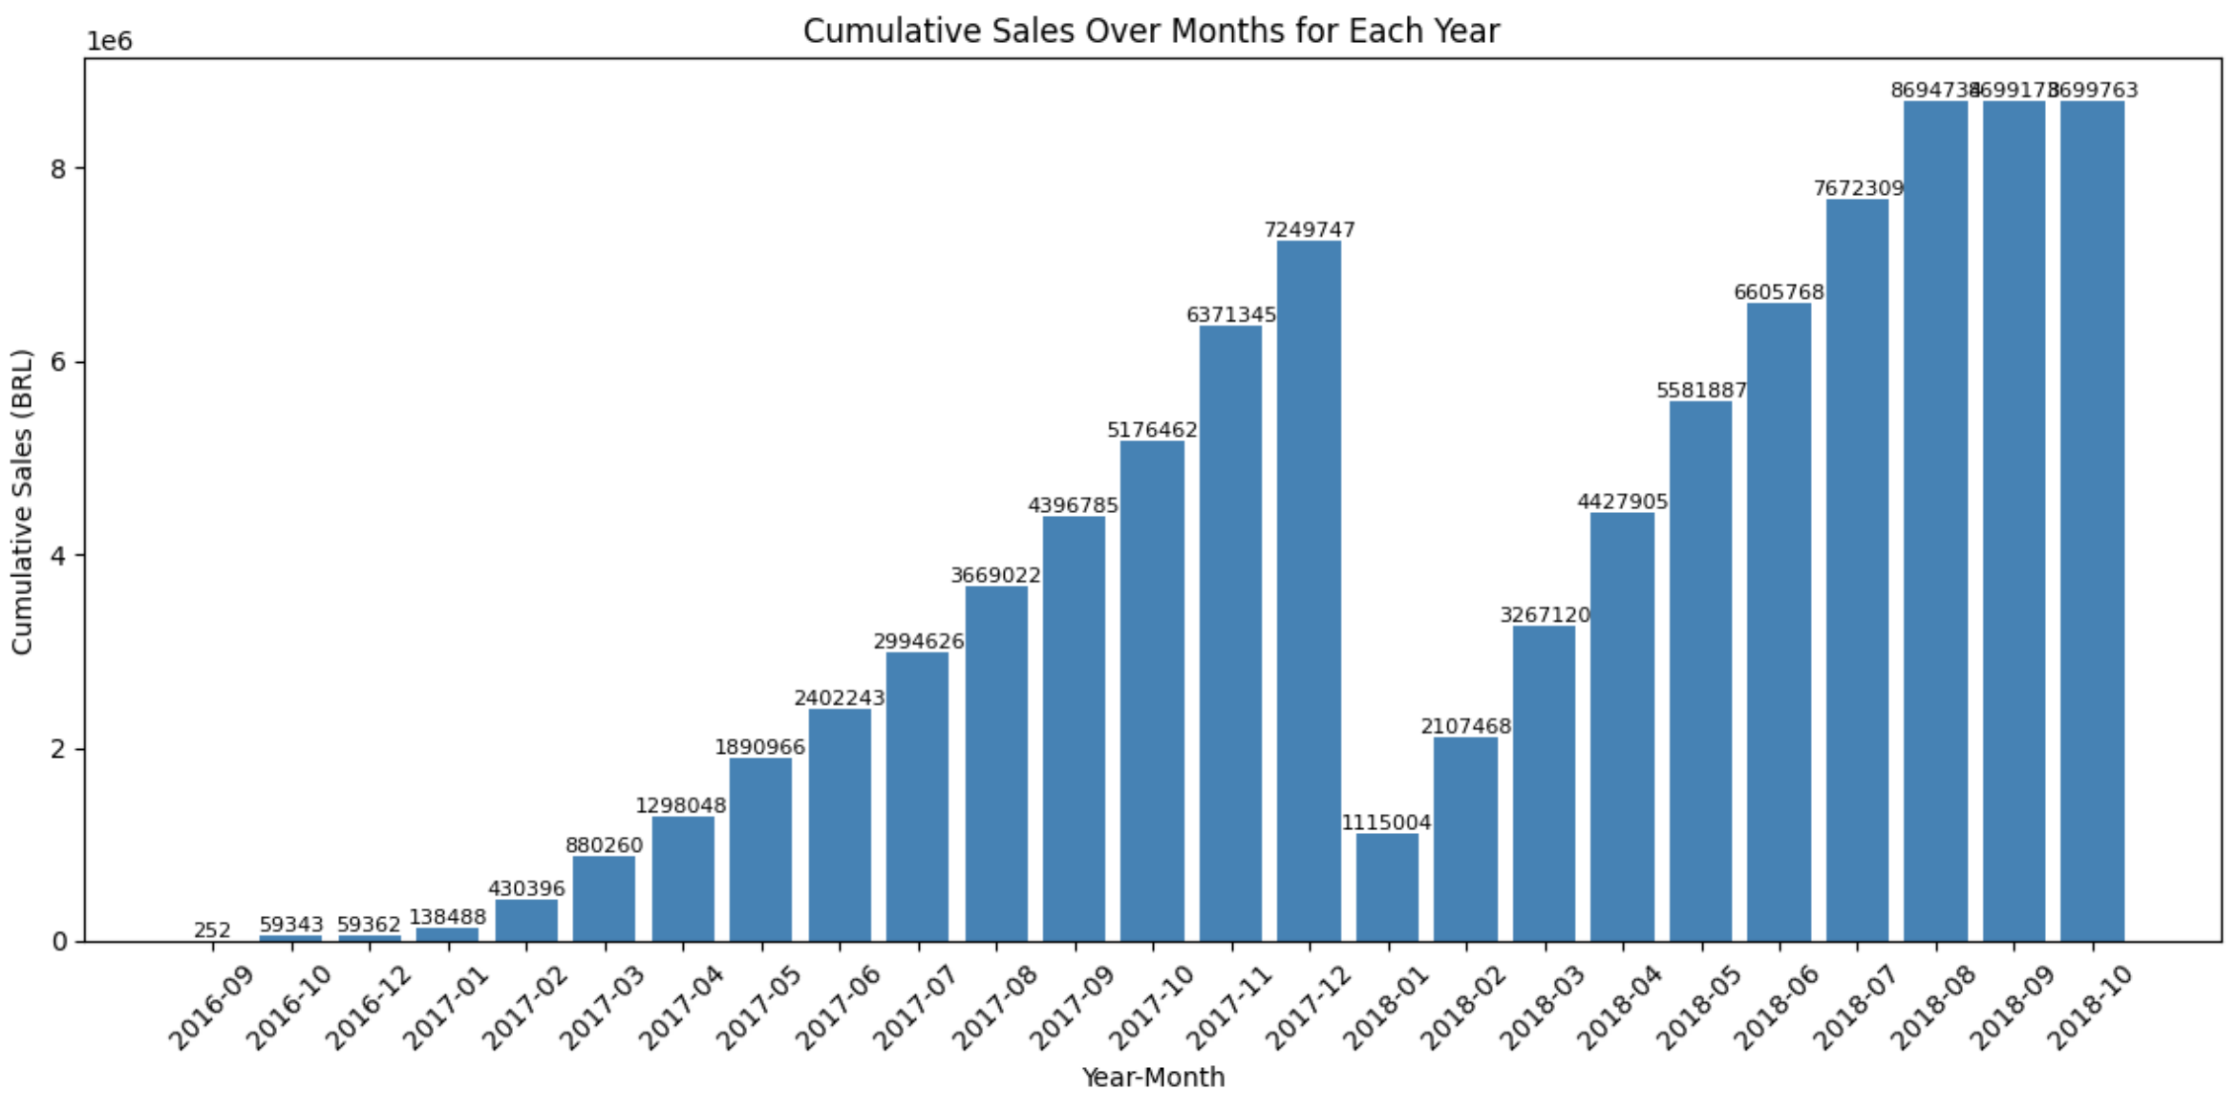
CUMILATIVE
SALES TREND
This calculates the total sales for each month and also the cumulative (running total) sales for each year over its months.
It groups sales data by year and month, sums payment values for each month, and then uses a window function to calculate the cumulative sum of sales within each year, ordered by month.
It shows not only monthly sales but also how sales accumulate throughout the year, giving insight into sales growth and trends over time.
The cumulative sales tend to rise steadily through the months of each year, indicating consistent growth, but certain months may show sharper increases, pointing to possible seasonal peaks or successful campaigns.
08

Slide 11
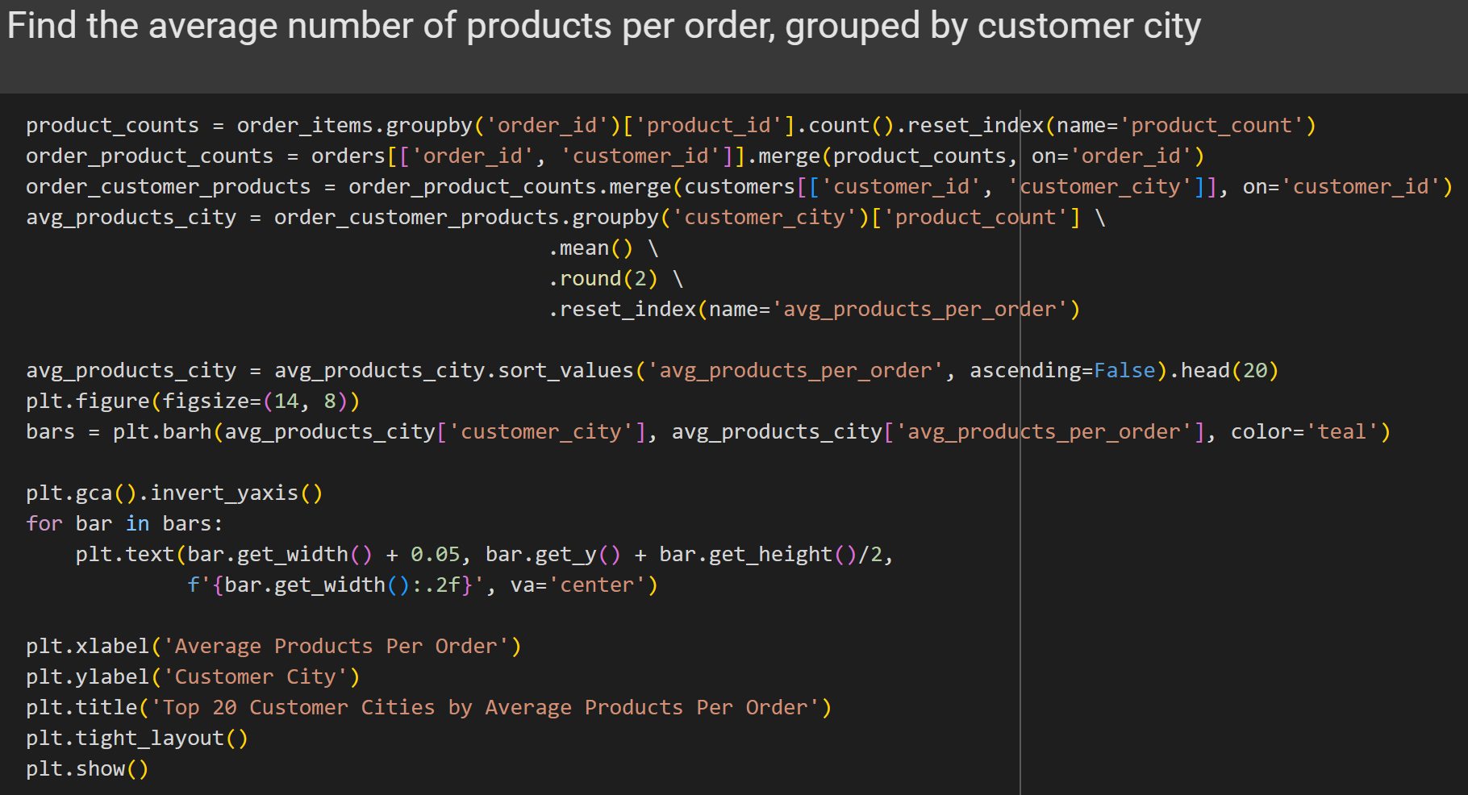
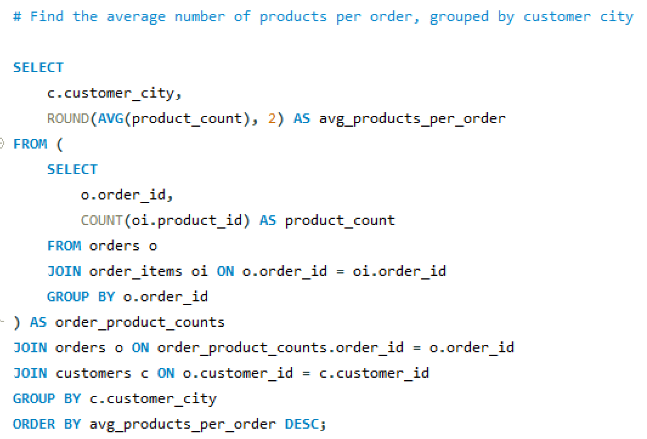
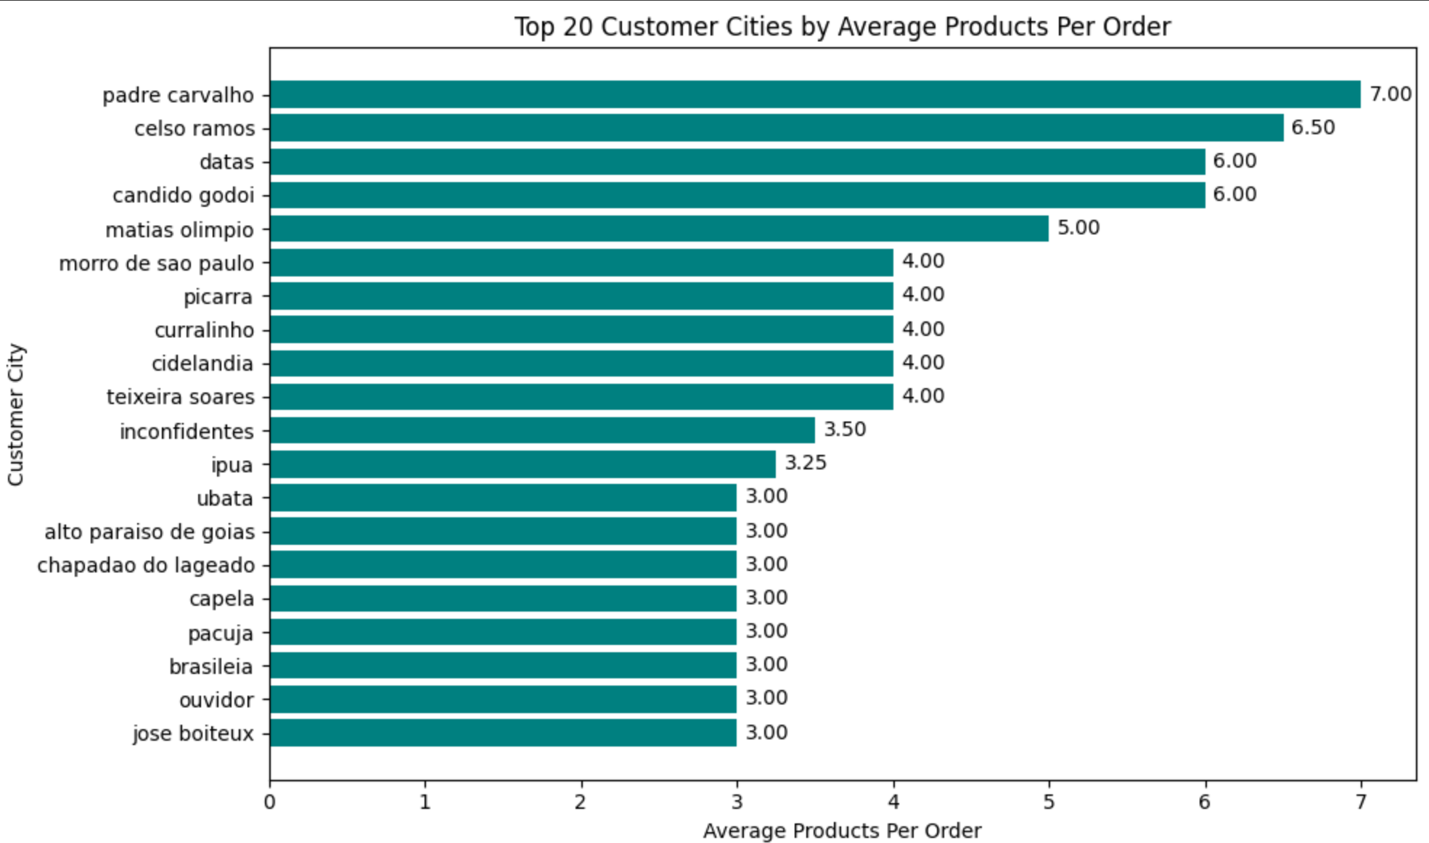
AVERAGE PRODUCTS
PER ORDER
This calculates the average number of products included in each order, grouped by customer city.
It shows the average quantity of products per order for each city, helping us understand where customers tend to purchase more items in a single transaction.
Cities with higher averages indicate more items bought per order — for example, cities like Nova Iguaçu or Campinas may show stronger buying behavior per transaction.
These insights help identify cities with high-order volume potential, which can be useful for optimizing logistics, targeting upsell strategies, or offering location-specific bundles.
08

Slide 12
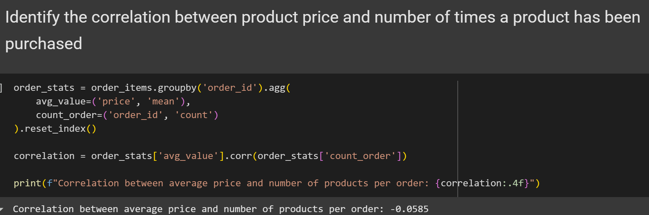
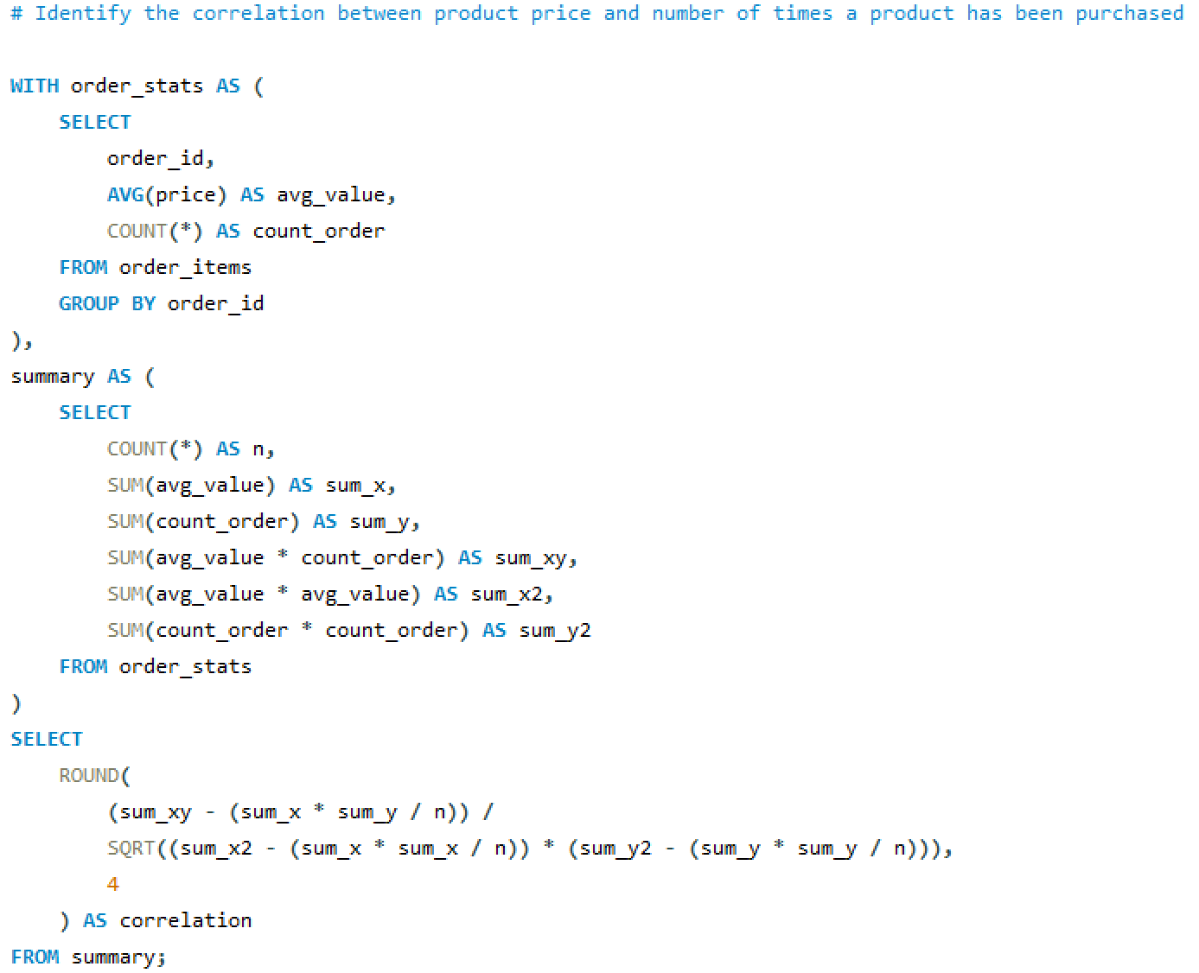
CORRELATION BETWEEN
PRODUCT PRICE & PURCHASED
This calculates the correlation between the average product price and the number of products in each order.
It helps us understand whether orders that contain more items tend to have higher or lower average prices.
A positive correlation value would suggest that orders with more items also have higher average prices, while a negative value would indicate that larger orders tend to contain cheaper products.
The output is -0.05 which shows a negative correlation.
08

Slide 13
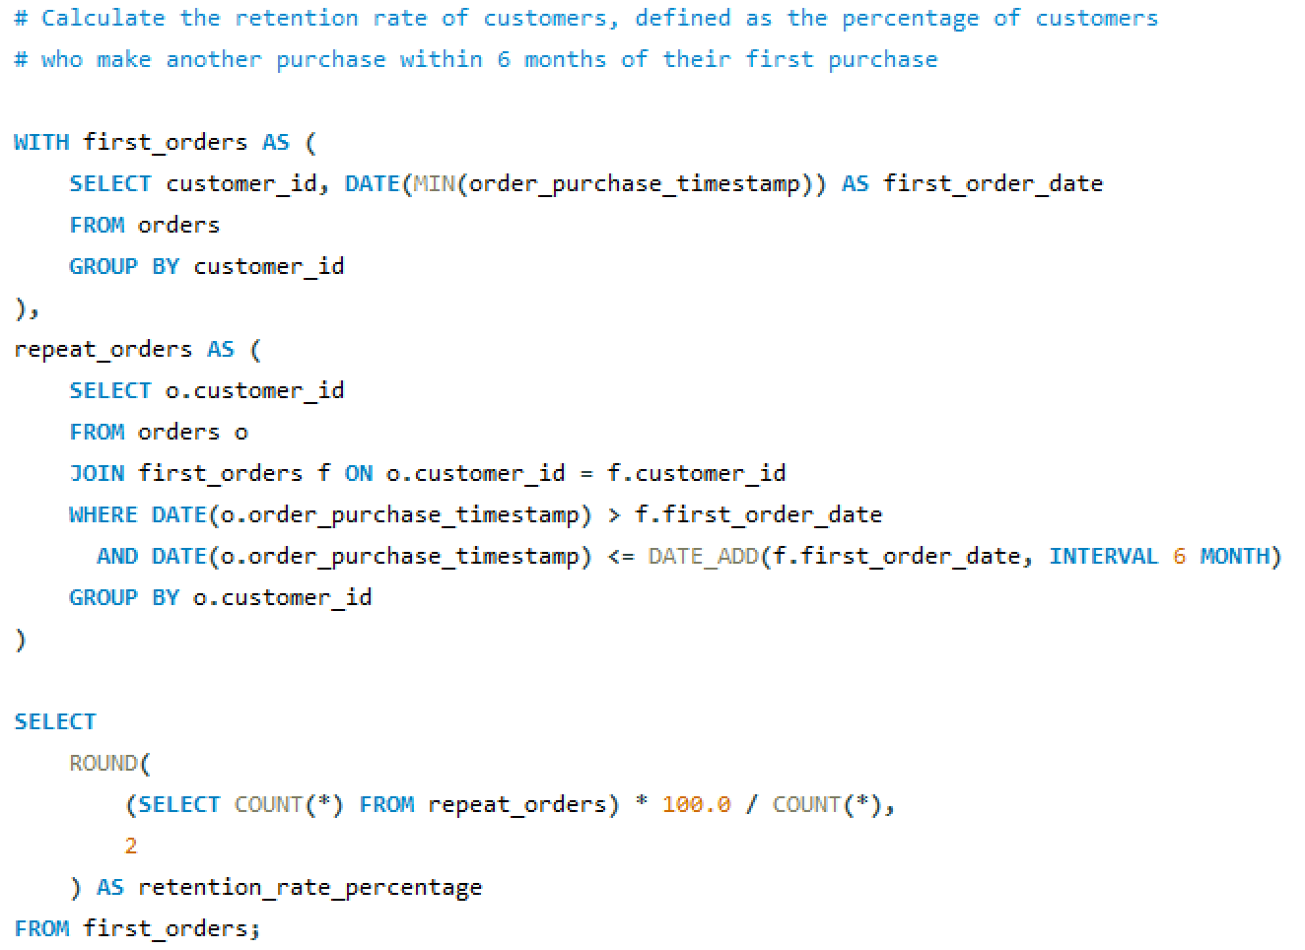
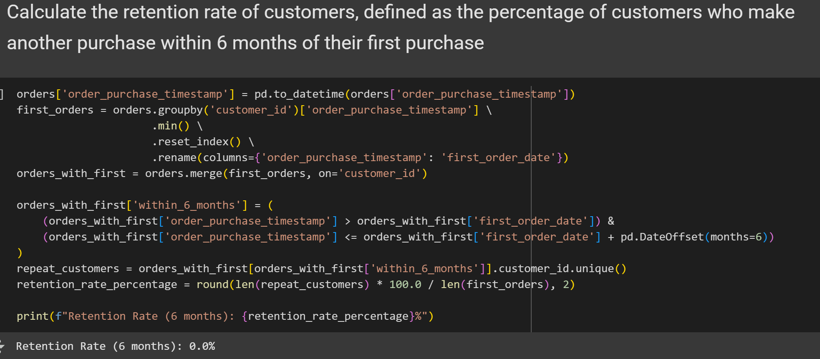
RETENTION
RATE
This calculates the percentage of customers who made at least one repeat purchase within six months after their first order.
It first finds each customer’s first order date, then checks if they placed any additional orders within six months after that date, counts those customers, and calculates their percentage out of all customers.
It shows how many customers stay loyal and keep buying from the store shortly after their first purchase, measuring customer retention.
The retention rate is 0%, meaning no customers made a repeat purchase within six months of their first order, which signals a significant challenge in customer retention and highlights a need to improve engagement and follow-up strategies.
09

Slide 14
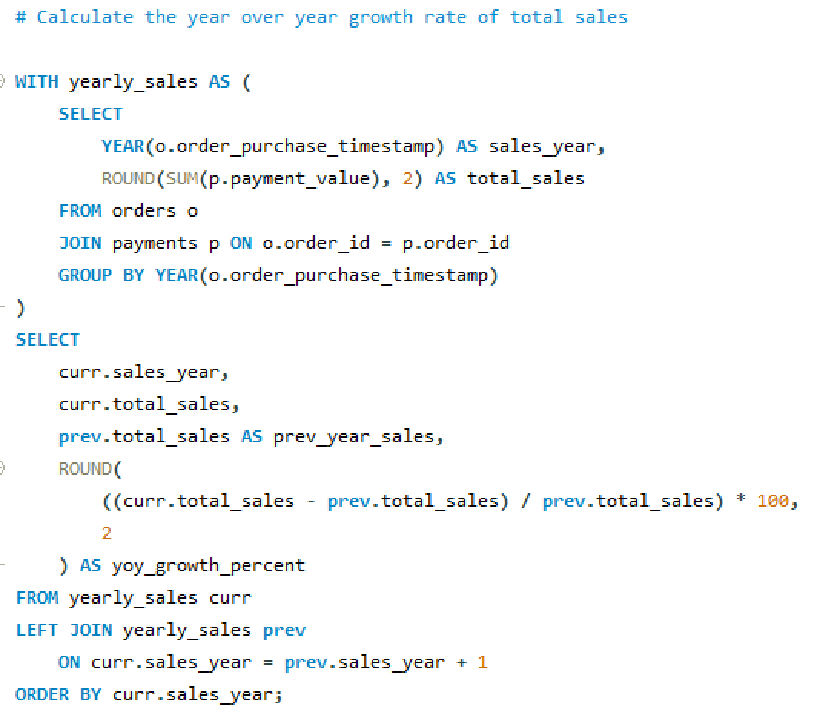
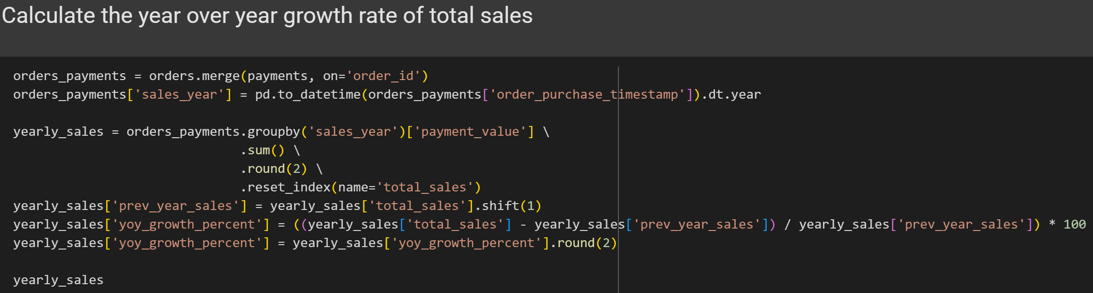
YEAR-ON-YEAR (YOY)
SALES GROWTH
This compares total sales for each year with the previous year to calculate the percentage growth or decline in sales year over year.
It first calculates total sales per year by summing payments, then joins the yearly sales data with itself offset by one year to find the previous year’s sales, and finally calculates the percentage change between the two years.
It shows how the business’s sales performance is changing year to year, indicating growth trends or declines over time.
The sales in 2017 grow over 12000% from 2016, showing a huge boost in sales and revenue, while 2018 saw a 20% jump from 2017.
SALES YEAR | TOTAL SALES | PREV YEAR SALES | GROWTH RATE
2016 | 59362.34 | NAN | NAN
2017 | 7249746.73 | 59362.34 | 12117.7
2018 | 8699763.05 | 7249746.73 | 20.0
10

Slide 15
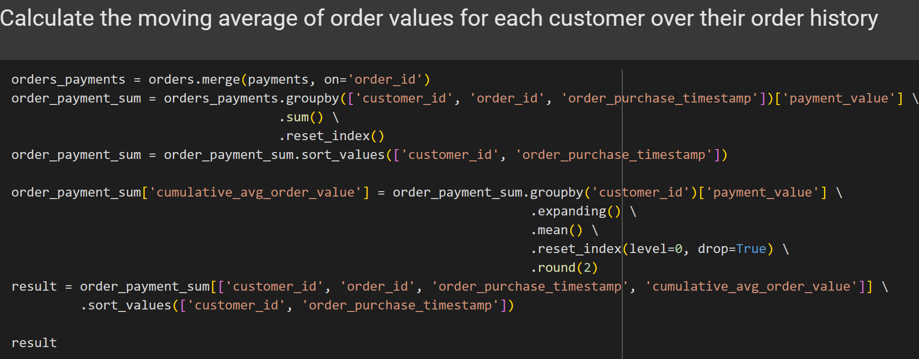
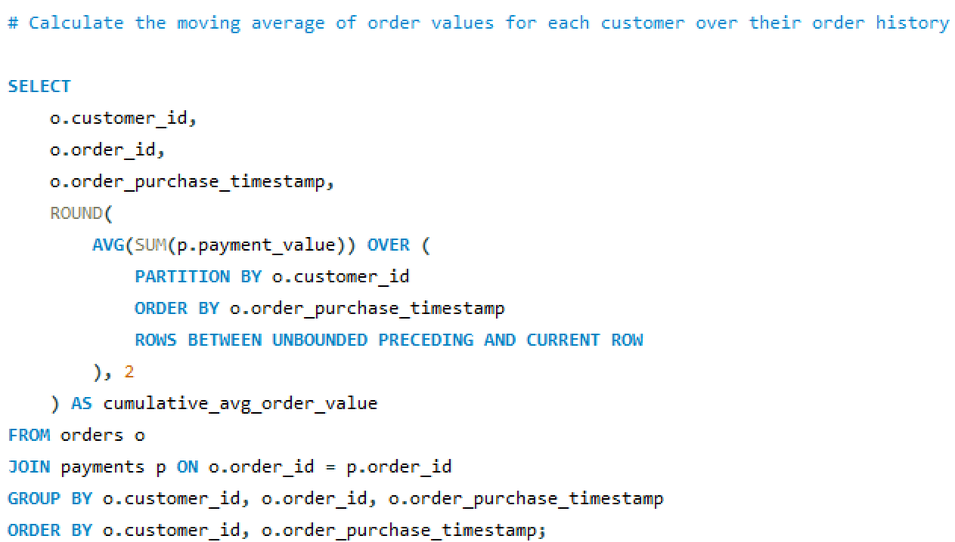
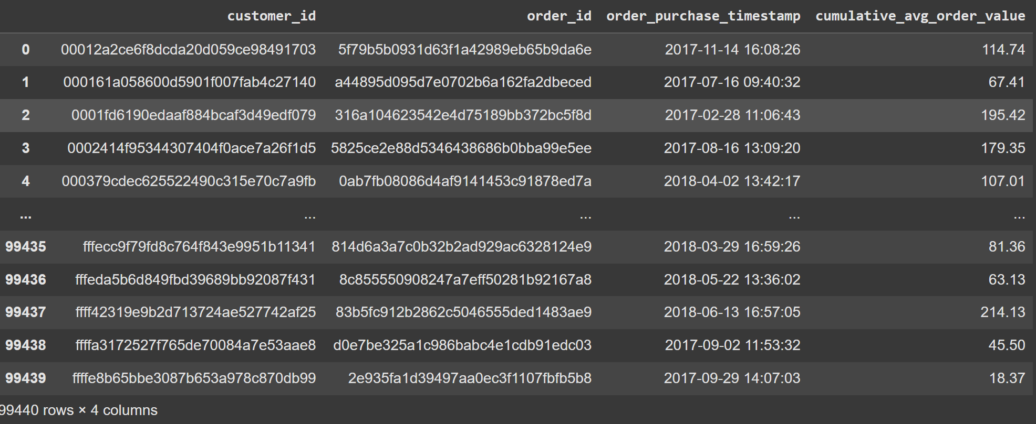
MOVING AVERAGE
OF ORDER VALUE
This calculates the moving (cumulative) average of order values for each customer across their entire purchase history.
It uses the orders and payments tables, merging them to get the payment_value for each order, then groups the data by customer and order date to track the value of each purchase.
This helps us understand how each customer’s average order value changes over time — for example, whether a customer is spending more or less as their order history grows.
The output shows the customer ID, order ID, order date, and the cumulative average order value revealing long-term purchase behavior and loyalty trends.
11

Slide 16
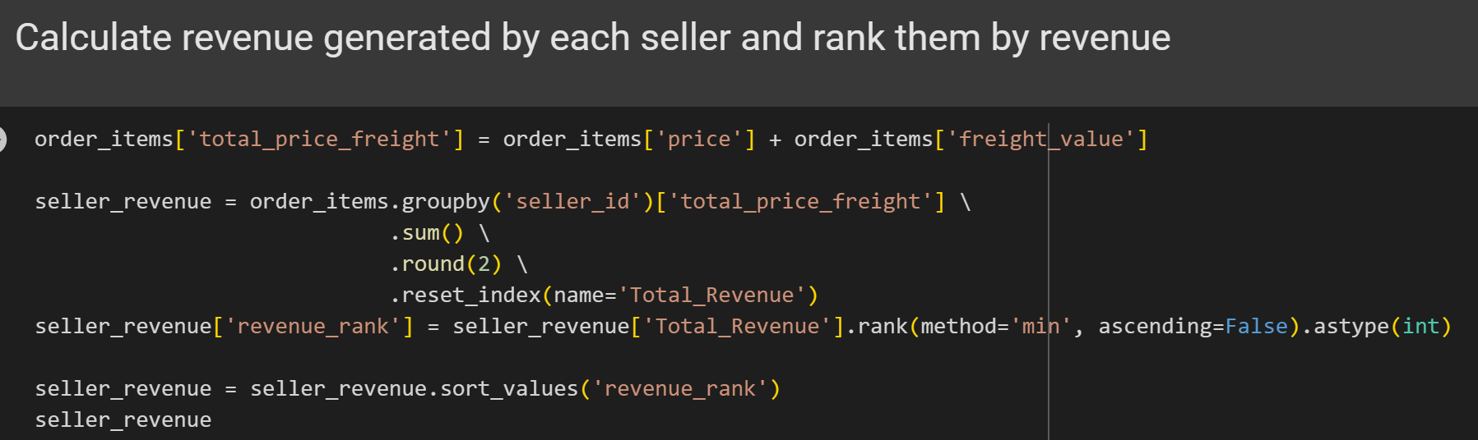
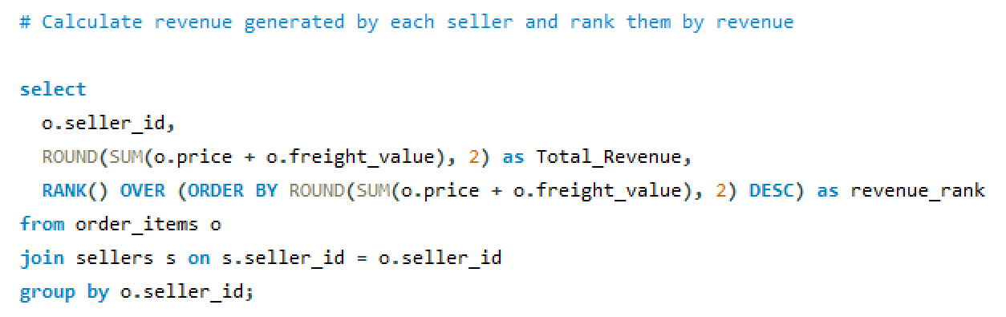
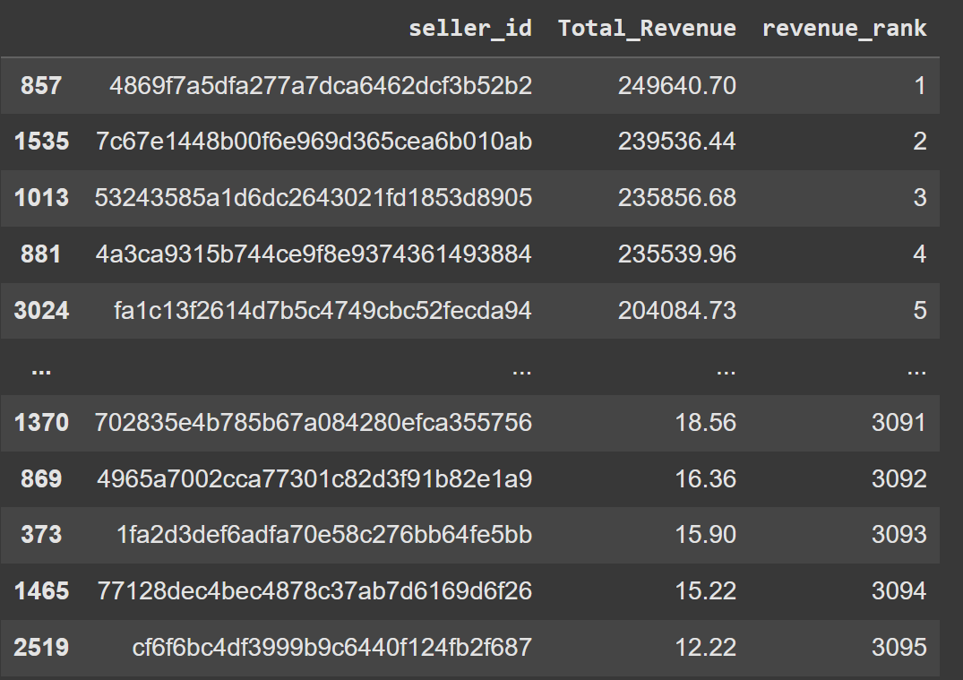
SELLER REVENUE
RANKING
This calculates how much revenue each seller earned and ranks them from highest to lowest based on total revenue generated.
It adds up each seller’s product price and freight value using the order_items table, groups the data by seller_id, and then uses the RANK() function to assign a rank based on descending revenue.
It shows which sellers are generating the most revenue on the platform, helping identify top-performing sellers.
Rank 1 seller generated sales of 2.5 BR, while seller of least rank generated sales of just 12 BR.
11

Slide 17
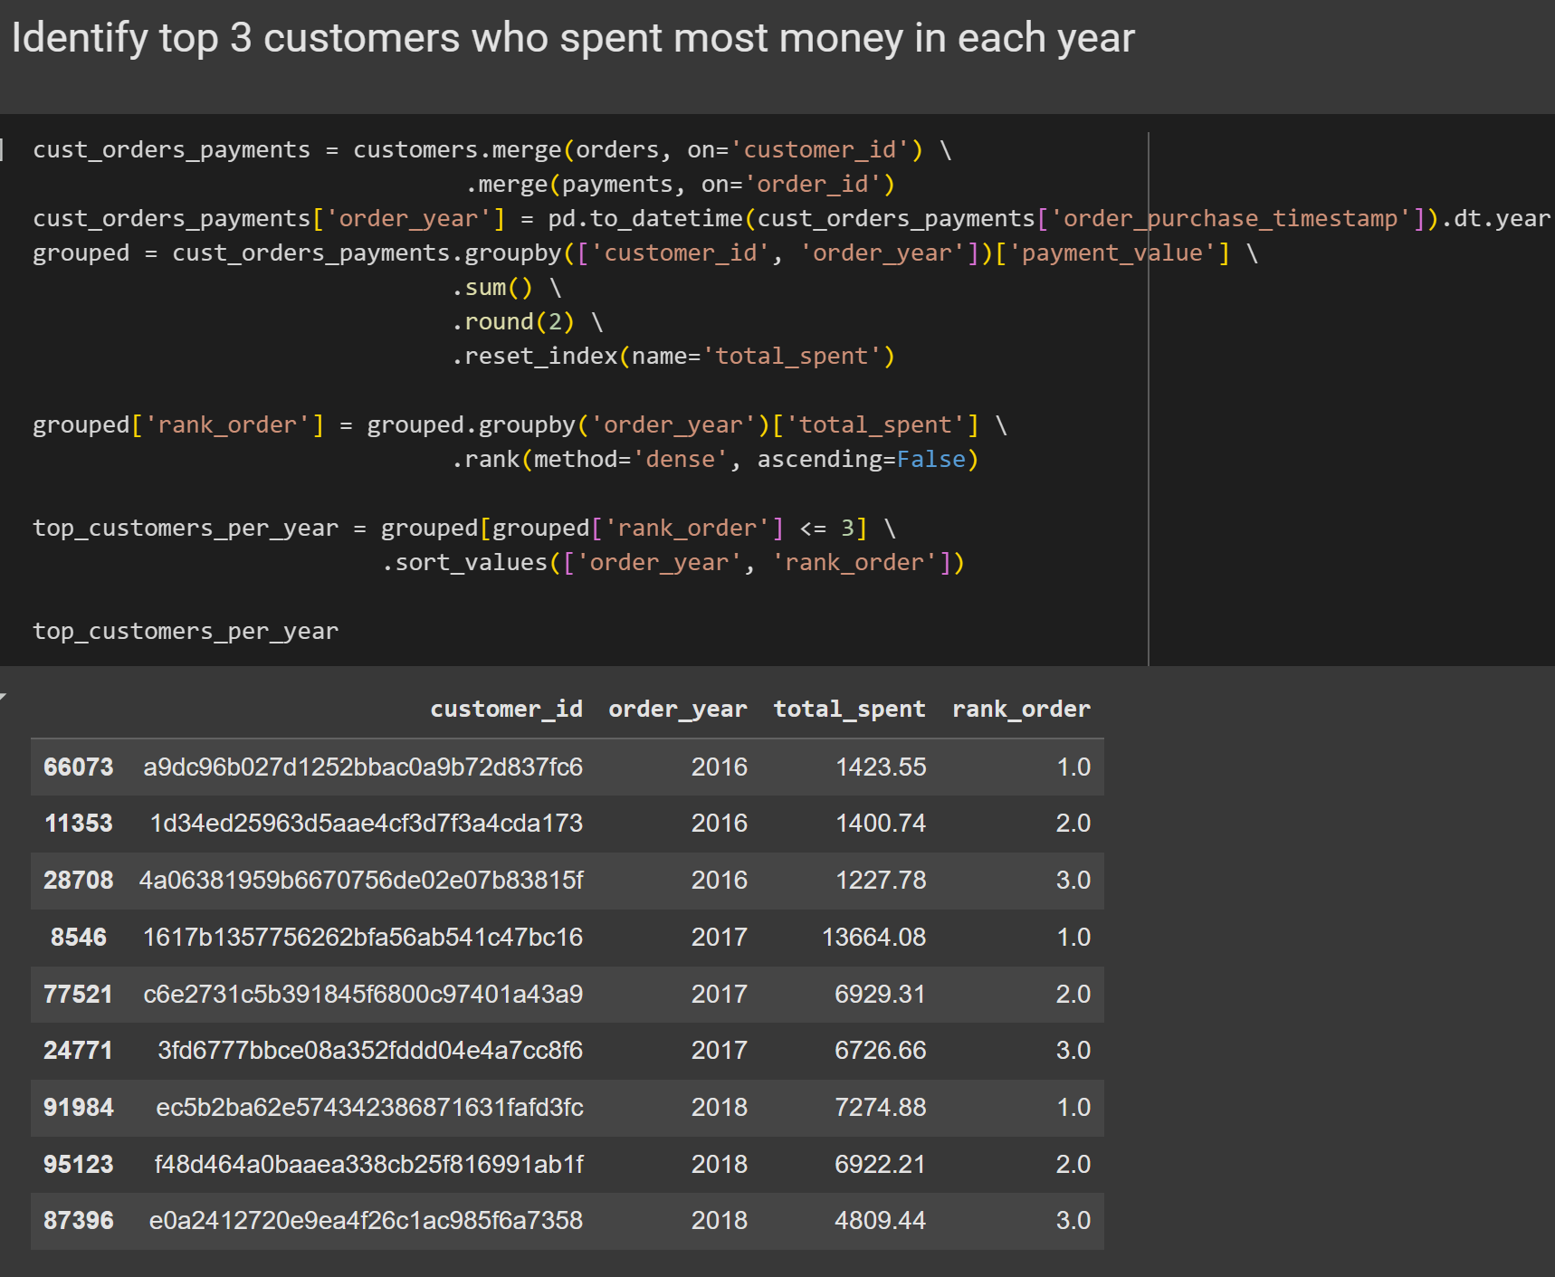
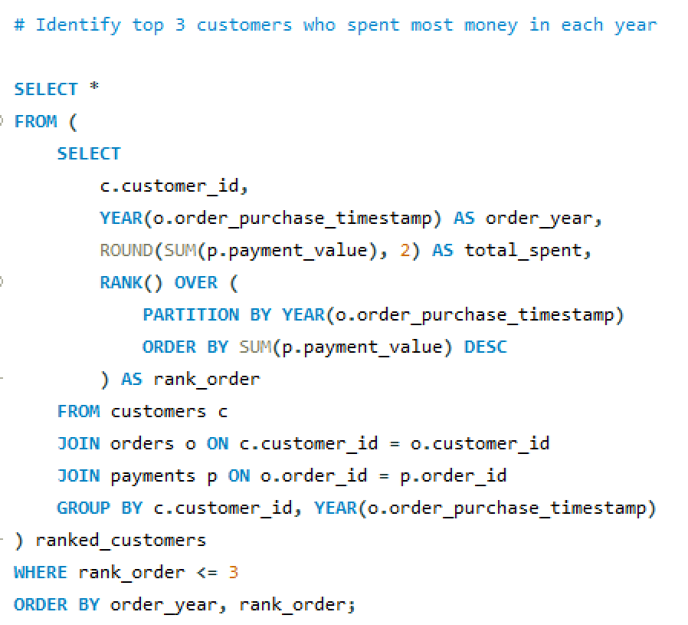
TOP 3 CUSTOMERS
PER YEAR
This identifies the top 3 customers who spent the most money in each year based on their total payment value.
It calculates the total amount spent by each customer in each year, and then ranks them within each year using the rank() function.
This helps us highlight the most valuable customers annually — those who contribute the highest revenue which is useful for loyalty programs, personalized offers, or VIP targeting.
The output includes the customer ID, year, total amount spent, and their rank showing the top 3 customers per year.
08

Slide 18

CONCLUSION
The platform recorded a significant number of orders in 2017, indicating good early traction and growth during that year.
A good portion of customers chose to pay in multiple installments, showing that flexible payment options are important for user convenience.
Categories such as watches_gifts and telephony contributed a large percentage to overall revenue, while several niche categories made up very little.
Most customers are concentrated in states like São Paulo, while some states have very few customers, indicating regional usage patterns.
The cumulative sales graphs show consistent monthly growth over each year, especially in 2018, which reflects increased customer activity and higher order volumes.
Sales have increased each year, showing overall growth and success in attracting more customers or encouraging more purchases.
A few sellers account for most of the revenue, with top sellers earning many times more than average ones. This shows a clear difference in seller performance.
Every year, a few customers spend much more than others, and identifying these high-value customers can help with loyalty strategies.
12

Slide 19
RECOMENDATIONS
Support and reward top sellers with better visibility or tools so they can keep contributing high revenue.
Launch marketing campaigns in states with fewer customers to spread platform usage more evenly across the country.
Promote installment payment options more clearly, as they seem to help increase customer spending and affordability.
Since the 6-month repeat purchase rate is 0%, a retention strategy should be launched. This could include email follow-ups, offers, or loyalty programs.
Invest more in stocking and promoting best-selling categories like health_beauty or telephony to maximize returns.
13

Slide 20

thank
you!
DATA ANALYSIS IS KEY TO BUSINESS GROWTH AND SUCCESS!
14

